Slide 1
CS3210 Tut 1
Processes, Threads and Synchronization Basics
Slides inspired by Sriram's slides with extra titbits

Slide 2
Quick Recap
Processes and Threads (Lec 2 & Lab 1)
Process basics and states
Threads (User-Level vs Kernel)
Mapping threads to kernel processes
IPC (shared memory, message passing)
Synchronization
Critical Section
Deadlock vs Livelock
Dealing with starvation
Mutexes
Semaphores
Condition Variables
Classic synchronisation problems
Producer-consumer
Reader-writer
Parallel Architectures (Lec 3 & Tut 1)
Concurrency vs Parallelism
Forms of parallelism (bit/instruction/thread/processor)
Flynn's taxonomy (SISD/ SIMD etc.)
Hierarchical, Pipelined, Network-Based designs
Memory organisation
Distributed-memory
Shared-memory
UMA, NUMA, ccNUMA, COMA
Hybrid

Slide 3
Focus: Forms of Parallelism
Bit Level
Instruction Level
Single Processor
Thread Level
Processor Level:
Shared Memory
Distributed Memory
Multi Processor

Slide 4
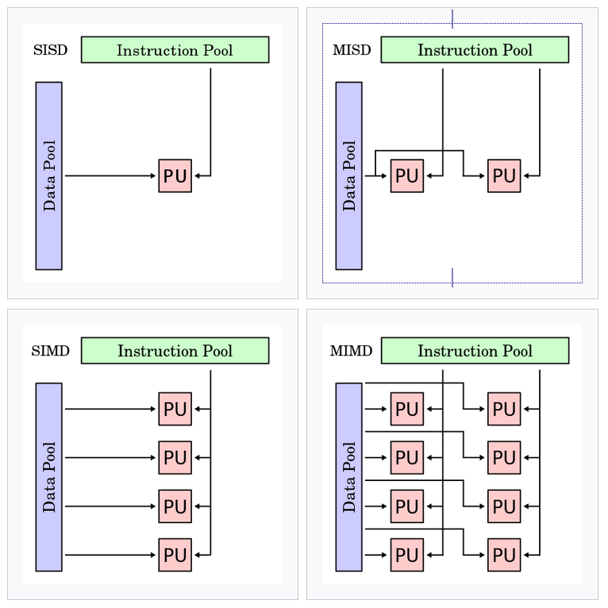
Focus: Flynn's Taxonomy
Identifying Single / Multi-Instruction
How many independent streams of executions are there?
Identifying Single / Multi-Data
How many logical blocks of data are we trying to operate on at a given point of time?

Slide 5
Part 1: Parallel Computing Architectures

Slide 6
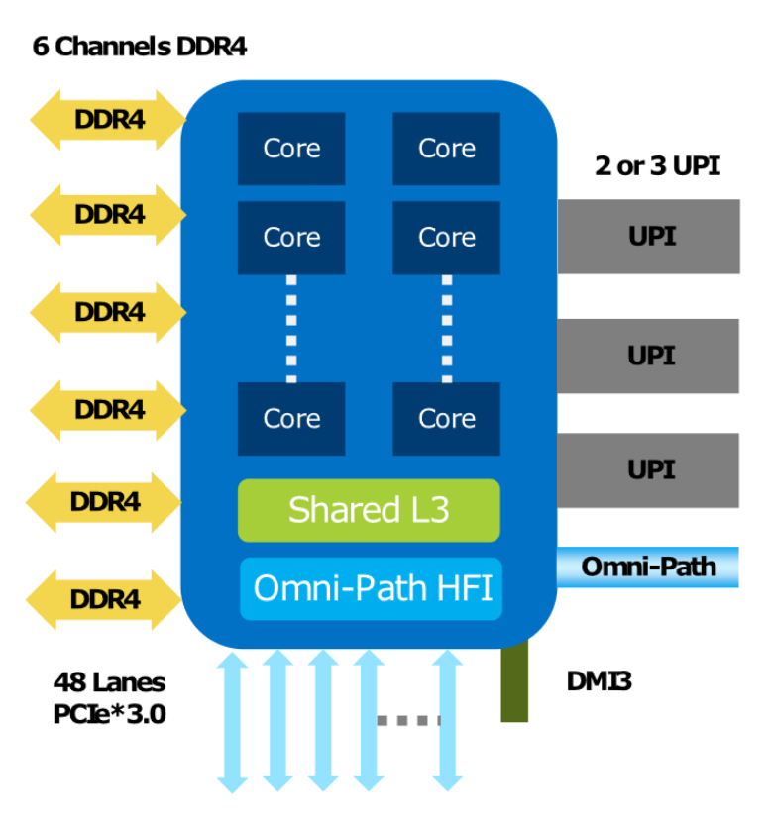
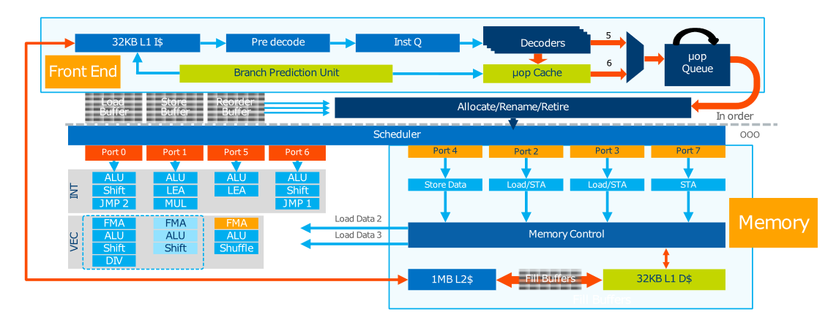
Q1: Identifying forms of parallelism

Slide 7
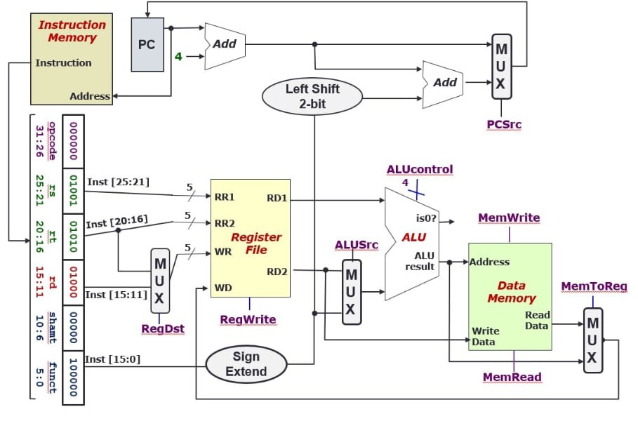
Let us map the chart to CS2100!
Executor

Slide 8
Let us map the chart to CS2100!
Instruction Fetch & Decode

Slide 9
Let us map the chart to CS2100!
Memory

Slide 10
Q1: Identifying forms of parallelism
Where do we find instruction level parallelism?

Slide 11
Q1: Identifying forms of parallelism
Where do we find instruction level parallelism?
A: Superscalar processing: multiple duplicated parts of processor pipeline

Slide 12
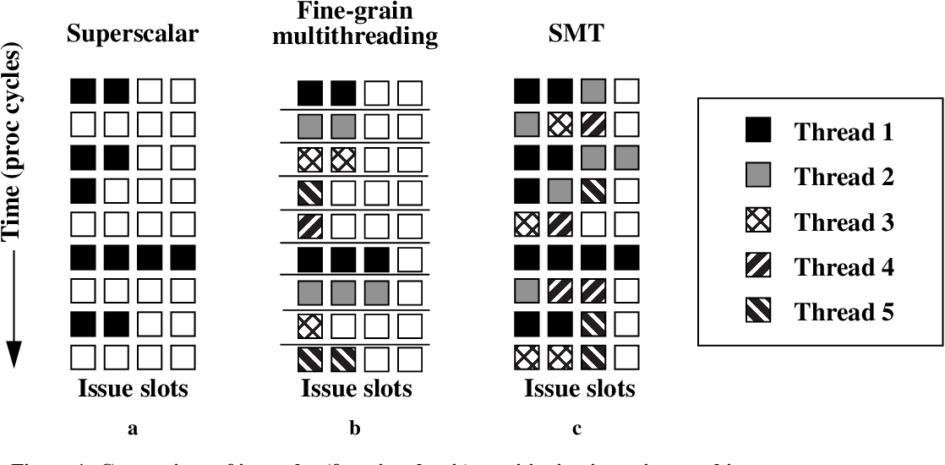
Superscalar vs SMT
Notes:
Superscalar is defined as the ability to dispatch instructions to multiple execution units. SMT is an improved version of superscalar.

Slide 13
Q1: Identifying forms of parallelism
Where do we find thread level parallelism?

Slide 14
Q1: Identifying forms of parallelism
Where do we find thread level parallelism?
A: Each core has 2 hardware threads, since Intel Xeon has Hyperthreading (SMT)

Slide 15
Q1: Identifying forms of parallelism
Where do we find processor level parallelism?

Slide 16
Q1: Identifying forms of parallelism
Where do we find processor level parallelism?
A: Multiple processor cores in a single CPU

Slide 17
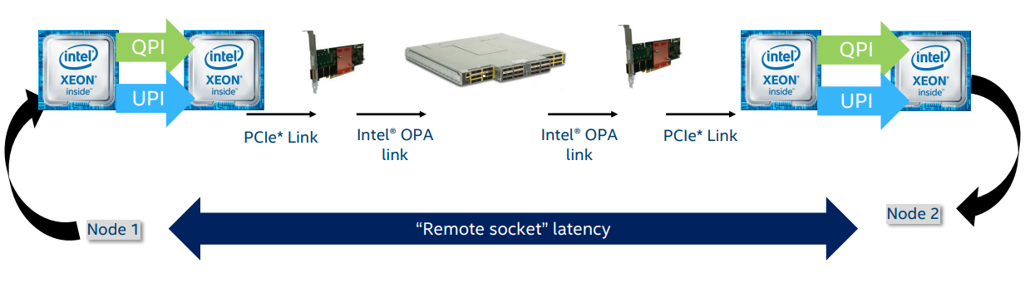
Q1: Identifying forms of parallelism
Where do we find processor level parallelism?
A: UltraPath Interconnect (UPI) Processor to Processor, for multi-CPU systems (shared memory)
A: OmniPath Architecture (OPA) Node to node (distributed memory)

Slide 18
Bonus: IO parallelism
Multiple DDR4 Channels
Multiple PCIe Lanes

Slide 19
Why does this matter?
Understanding our hardware better allows us to make better decisions on how to parallelize.
Node has multiple processors without high-speed interconnect? Keeping tasks to 1 processors may be more preferable.
Cores do not have superscalar ability? Maybe decompose simpler tasks over many cores.

Slide 20
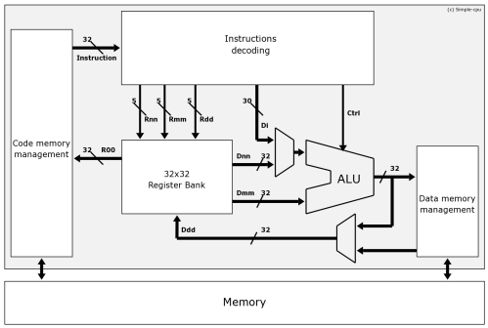
Q2: Flynn's Taxonomy
Architecture for a personal computer from the 1980?
A: SISD - one instr and data stream. IBM Power4 is only released in 2001!

Slide 21
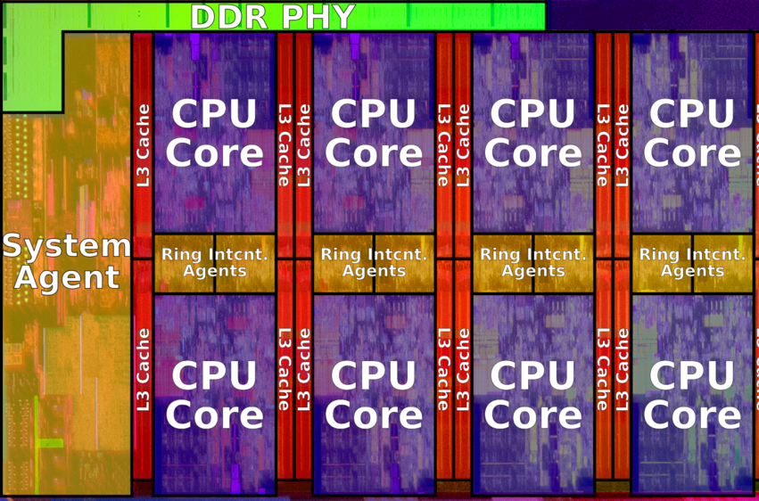
Q2: Flynn's Taxonomy
Architecture for a multi-core laptop?
A: MIMD - Each core runs independently with their own independent data

Slide 22
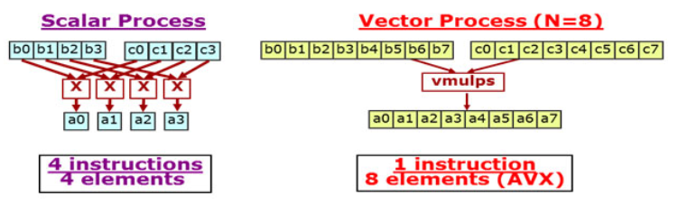
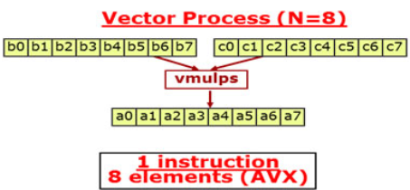
Q2: Flynn's Taxonomy
Architecture Intel AVX instruction set?
A: SIMD - One instruction operates on multiple data blocks

Slide 23
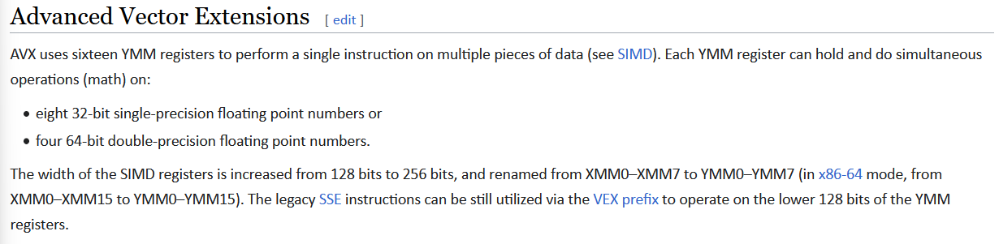
Further reading: Intel AVX
Intel processors with AVX support can do:
Scalar instructions - Interact with a single YMM register at once
Vector instructions - Interact with all the YMM registers at the same time (to perform vector calculations)
Ref: https://www.intel.com/content/dam/develop/external/us/en/documents/intro-to-intel-avx-183287.pdf

Slide 24
Q2: Flynn's Taxonomy
Single core processor with pipelining?
A: SISD: Same as first question

Slide 25

Q2: Flynn's Taxonomy
Architecture for students in an exam hall?
A: MISD - Exam script (the "data") is the same for all students (the "processors")

Slide 26
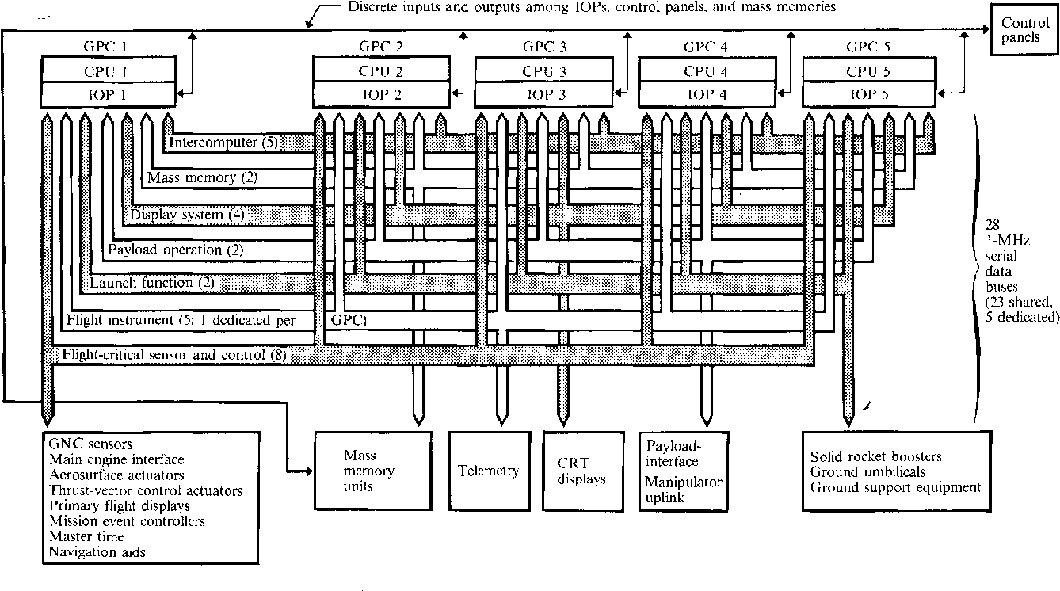
Bonus: Flynn's Taxonomy - Space Shuttle CPUs (MISD)
https://www.semanticscholar.org/paper/Redundancy-Management-Technique-for-Space-Shuttle-Sklaroff/eb225e9ad32eaeb29583ee0806d9381522de4959

Slide 27
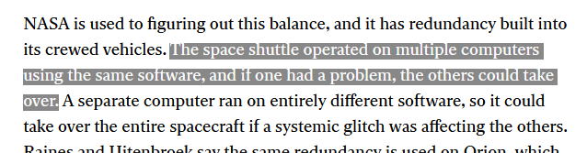
Bonus: Flynn's Taxonomy - Space Shuttle Computers
Fun fact about Crew Dragon (MISD? MIMD? It depends on how you look at it…)
https://www.technologyreview.com/2020/07/03/1004788/spacecraft-spacefight-autonomous-software-ai/

Slide 28
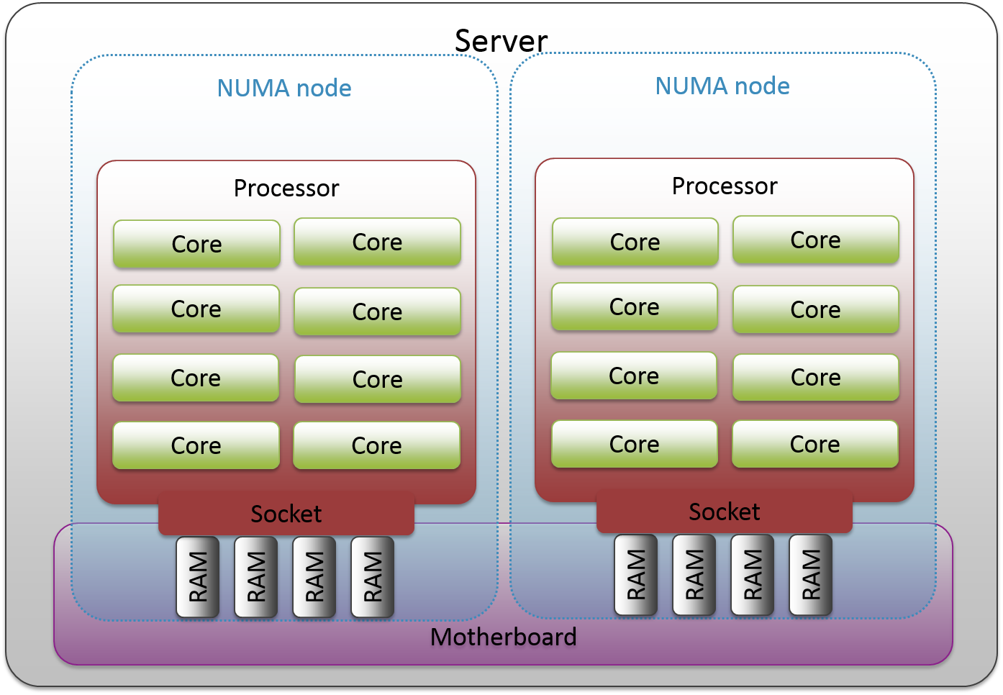
Q3: Memory & Multicore Architectures
Shared memory implies a UMA architecture? (T/F)
No, shared memory can be in NUMA architectures too!

Slide 29
Q3: Memory & Multicore Architectures
NUMA architecture implies that actual location of data has no impact on effect (on the access times for different processors)?
No, knowing the location of data is important in a NUMA architecture! (so that you can optimize data access times - IO is often the bottleneck)

Slide 30
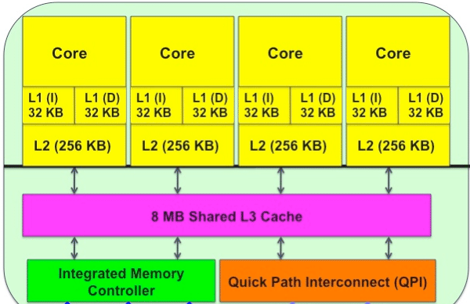
Q3: Memory & Multicore Architectures
In hierarchical multi-core designs, is the memory organization hybrid (distributed + shared memory)?

Slide 31
Q3: Memory & Multicore Architectures
In hierarchical multi-core designs, is the memory organization hybrid (distributed + shared memory)?
It depends!
Not hybrid: Everyone can only see one shared memory
Hybrid: Treat the processing core caches as memory - cache is distributed and unique to each core!

Slide 32
Q4: Processes and Threads
Can we replace a mutex with a semaphore without affecting correctness?

Slide 33
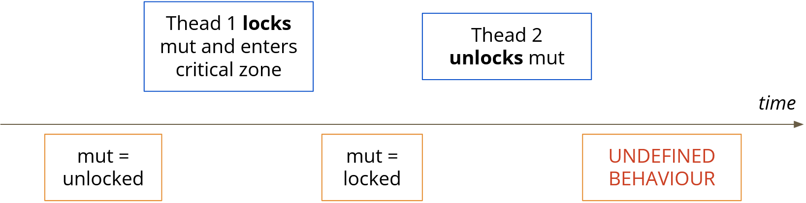
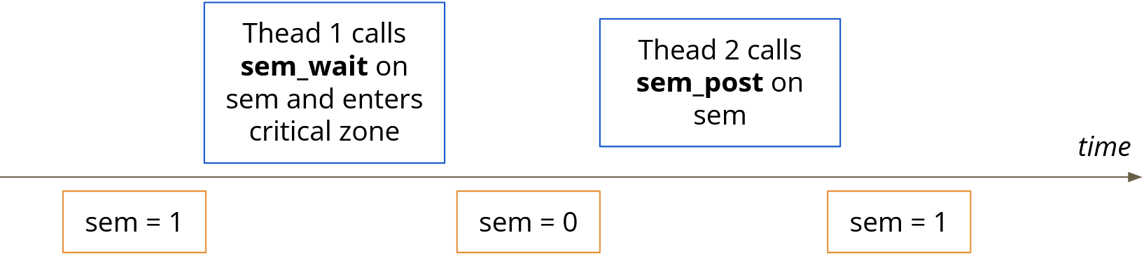
Q4: Processes and Threads
Can we replace a mutex with a semaphore without affecting correctness?
Yes! If a program implemented with a mutex is already correct, we can replace it with a semaphore without affecting correctness!
This is not true for the opposite! (We went through this in Lab 1)

Slide 34
Q4: Processes and Threads
Is a program implemented with threads faster than processes?

Slide 35
Q4: Processes and Threads
Is a program implemented with threads faster than processes?
Not necessarily!
Could be user-level threads (mapped to 1 process) - they will end up running slower

Slide 36
Part 2 & 3: Practical Slurm Usage
Stuff copy pasted from Sriram's slides

Slide 37
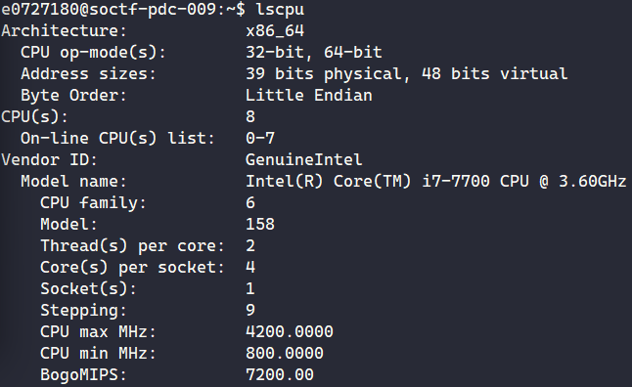
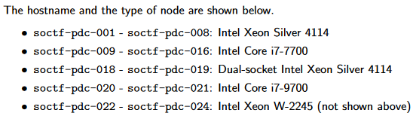
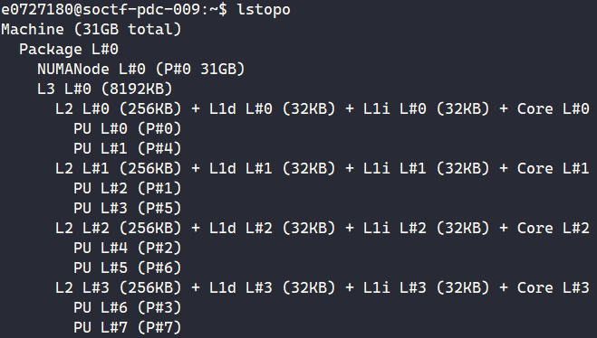
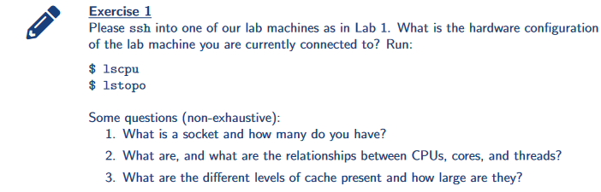
ex1: Login into a machine and run lscpu; lstopo

Slide 38
ex1: Login into a machine and run lscpu; lstopo
What are the differences between sockets/cores/threads?

Slide 39
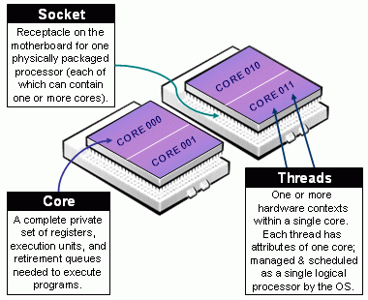
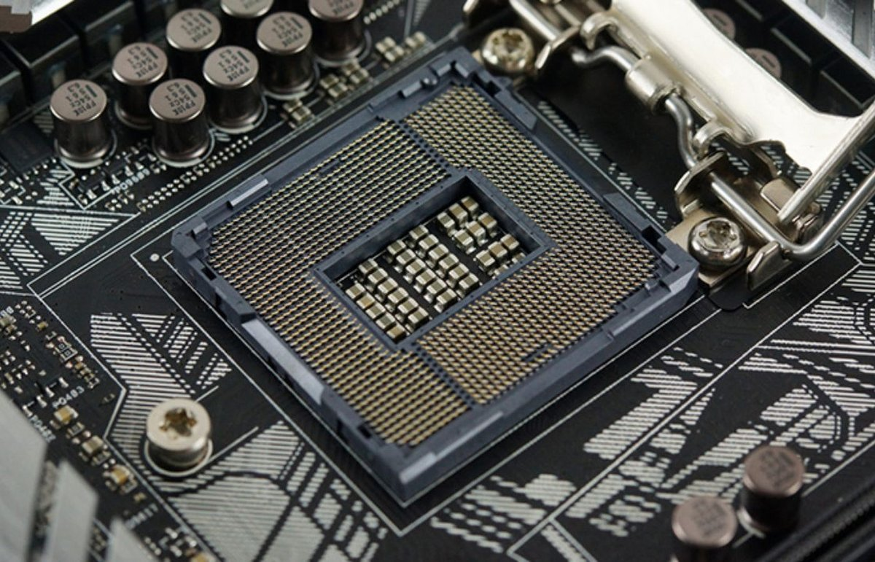
ex1: Login into a machine and run lscpu; lstopo
What are the differences between sockets/cores/threads?
Threads: Single hardware threads of execution (typical processing cores with SMT have 2)
Core: Single set of usable hardware for executing code
Socket: The physical pins/slots that connects the CPU to the system's motherboard (Note: not your networking sockets!)
Intel LGA1700 socket → For 12/13th Gen Intel desktop CPUs

Slide 40
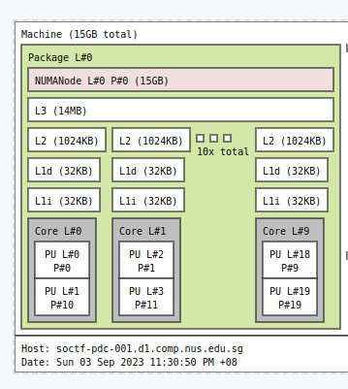
Understanding lstopo
lstopo --of svg > topo.svg

Slide 41
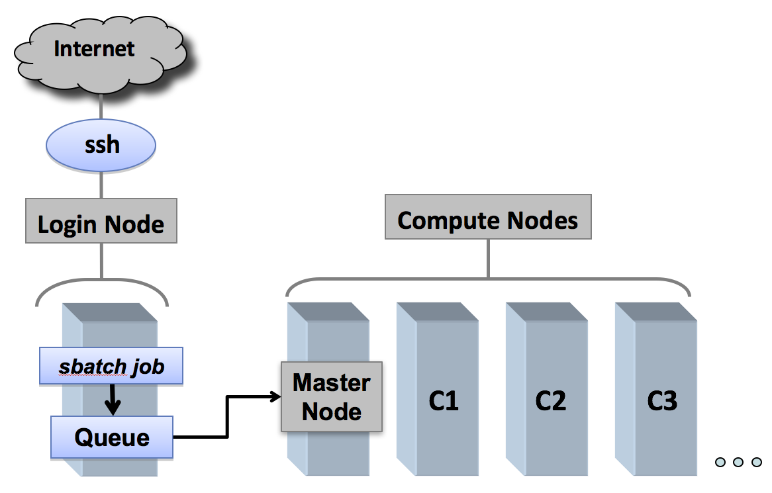
Introducing Slurm Workload Manager
Job allocation system
Fair allocation of compute resources
Exclusive access to nodes for performance measurements
Wide variety of machines to test on and run distributed programs on

Slide 42
Why Now?
SoC uses Slurm for our entire compute cluster
Best parallel computing systems use Slurm (>60% of TOP500)
A way to get good performance when no. of systems < no. of users → Good for CS3210!
Do not run long jobs on login nodes anymore!

Slide 43
Disclaimers
Please let us know if there are any issues (see last page of tutorial for who to contact)
Our "best practices" and policies may change. Please refer to https://bit.ly/cs3210-student-guide for updates.

Slide 44
Your NFS Home Directory
Your /home/username directory is local to your node
(not shared)
Your /nfs/home/username directory is a network filesystem (NFS) between all nodes
Shortcut: you can access it with cd /nfs$HOME
How much slower is NFS than node-local storage?
dd if=/dev/zero of=/nfs$HOME/test.img bs=100MB count=1 oflag=dsync
dd if=/dev/zero of=~/test.img bs=100MB count=1 oflag=dsync

Slide 45
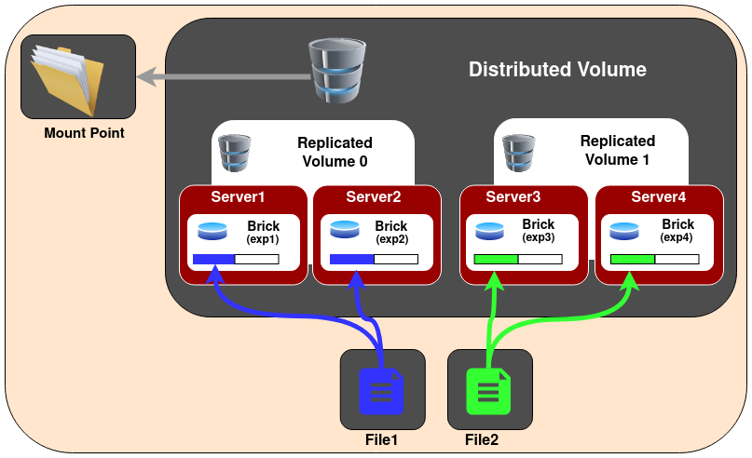
Your NFS Home Directory
The NFS is distributed + replicated with "GlusterFS"
4 servers (17/22/23/24), each server has half the files.
We can still recover from loss of 1 server, maybe even 2.

Slide 46
Let's get started!
ex3 - ex12: Small guided exercises working through the basics
ex13: Basic performance evaluation with Slurm
Please bring up any interesting observations!
For me:
watch -n 0.5 squeue
watch -n 0.5 sprio

Slide 47
Slurm: Priority and Share
Everyone run together: srun -w soctf-pdc-005 sleep 10
sprio -l
Who has more priority?
sshare -a
Who’s been using the most?

Slide 48
Special Topics in Slurm: Broad runtime statistics
You can find some information about running job statistics with sstat
sbatch cond.sh
sstat -o jobid,nodelist,ntasks,avecpu,averss,maxrss,maxdiskread,maxdiskwrite <jobid>
However, we'll explore other tools for your better performance tracking (perf, etc.)

Slide 49
Sneak Peek at Performance Evaluation
Let’s try to measure how long a program takes
srun -p xs-4114 time ./pthread_addsub
srun -p xs-4114 /usr/bin/time -vvv ./pthread_addsub
srun -p xs-4114 perf stat ./pthread_addsub
srun -p xs-4114 perf stat -r 3 ./pthread_addsub
srun -p xs-4114 hyperfine -M 5 ./pthread_addsub

Slide 50
Sneak Peek at Performance Evaluation
Are there hardware differences?
srun -p xs-4114 hyperfine ./pthread_addsub > xs4114.out
srun -p dxs-4114 hyperfine ./pthread_addsub > dxs4114.out
srun -p i7-7700 hyperfine ./pthread_addsub > i77700.out
srun -p i7-9700 hyperfine ./pthread_addsub > i79700.out
srun -p xw-2245 hyperfine ./pthread_addsub > xw2245.out
tail -n +1 xs4114.out dxs4114.out i77700.out i79700.out xw2245.out

Slide 51
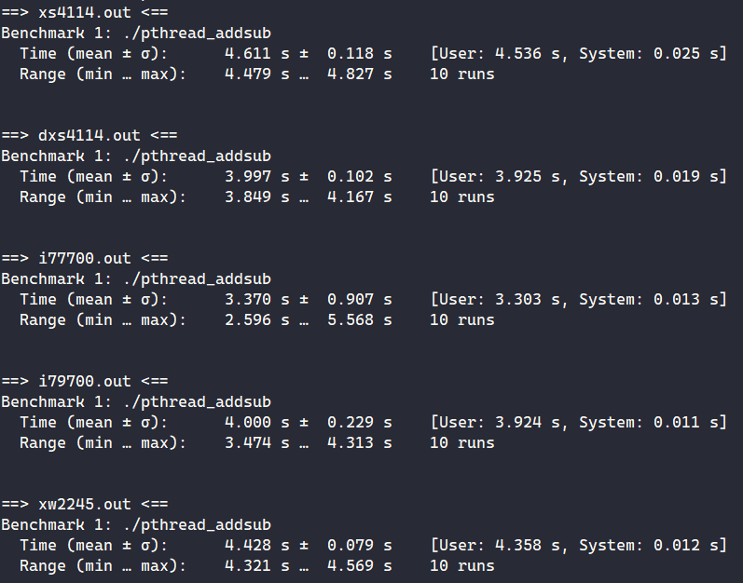
Processing the results

Slide 52
Results (8 add + 8 sub threads)
4T/8C i7-7700 CPU @ 3.60GHz: 3.370s
8T/8C i7-9700 CPU @ 3.00GHz: 4.000s
10T/20C Xeon Silver 4114 @ 2.20GHz: 4.611s
2x 10T/20C Dual-Socket Xeon Silver 4114 @ 2.20GHz: 3.997s
8T/16C Xeon W-2245 @ 3.90GHz: 4.428s
We are also not too sure why the W-2245 is only barely faster than the Xeon Silver 4114 node - we predicted that it would be much faster!
Free brownie points to anyone who can find out why :)
Notes:
To verify clock speeds:
srun -p xs-4114 grep "^[c]pu MHz" /proc/cpuinfo
srun -p xw-2245 grep "^[c]pu MHz" /proc/cpuinfo

Slide 53
Summary
Parallel architectures
Flynn’s taxonomy
Memory, Processes vs threads
Slurm usage

Slide 54

End of Tut 1
Slides are uploaded here after every session GDrive: drive.zhiheng.dev
Anonymous Feedback: feedback.zhiheng.dev
Reminder: Submit your Lab 1 by tomorrow 2pm!
Attendance

